Slide 2
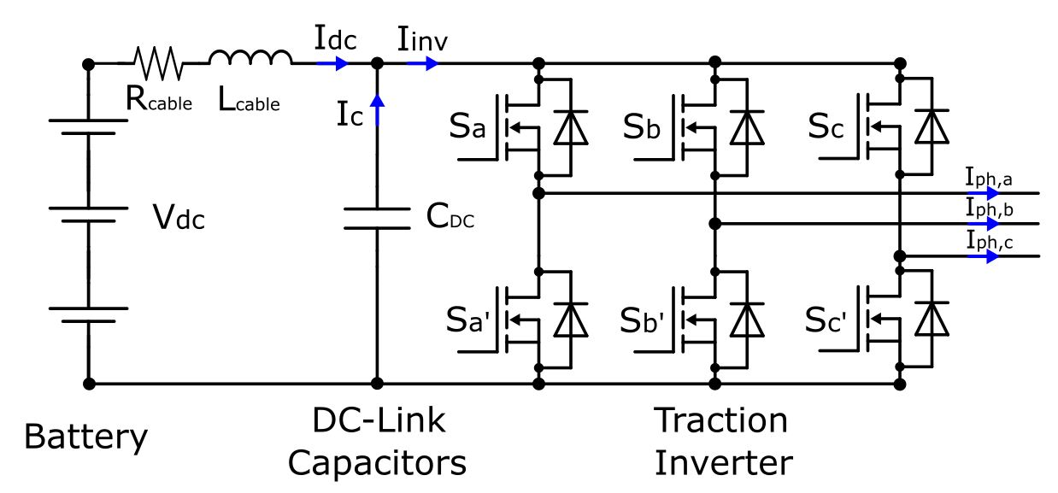
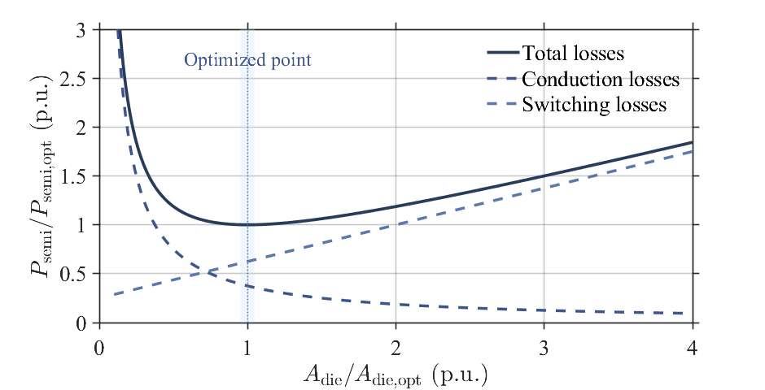
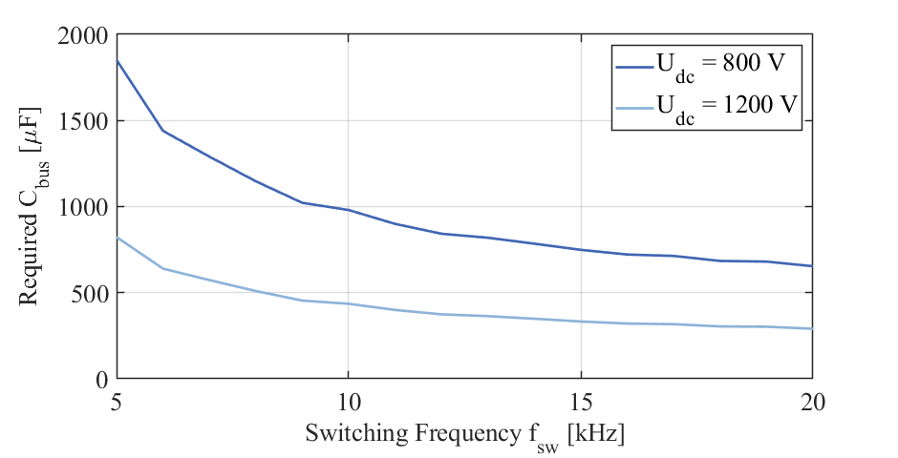
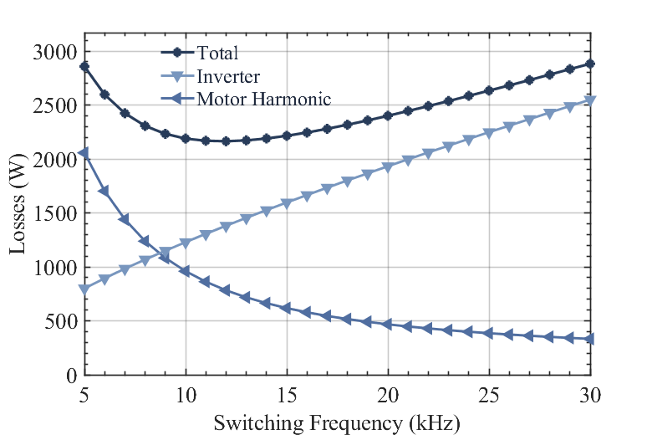
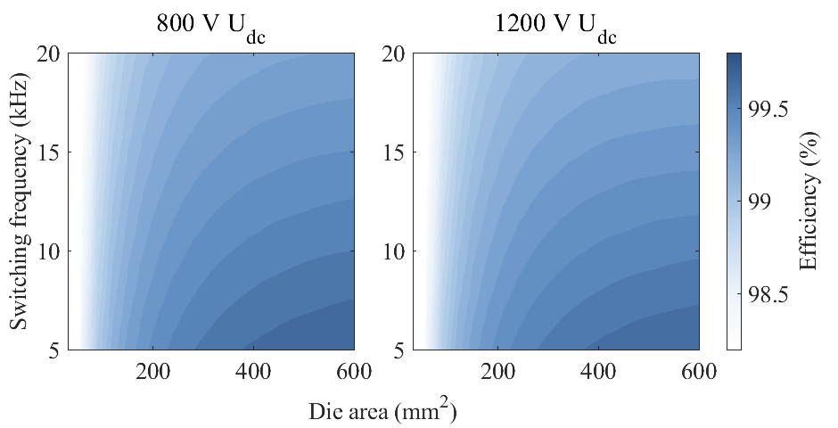
Raising the DC-Link Voltage in Traction Inverter
Transitioning to 1200 V DC-link (from 800V) reduces current by ~45 % for the same power.
Lower current → lower conduction and copper losses (~40 %).
Enables Megawatt fast charging
Two-level SiC inverter remains compact and efficient at higher voltage.
Optimal die area & switching frequency (≈ 14 kHz) selected for loss balance.
Achieves η ≈ 99.5 %, ~35 % smaller DC-link capacitor volume.
Enes Ayaz enesa@kth.se

Slide 3
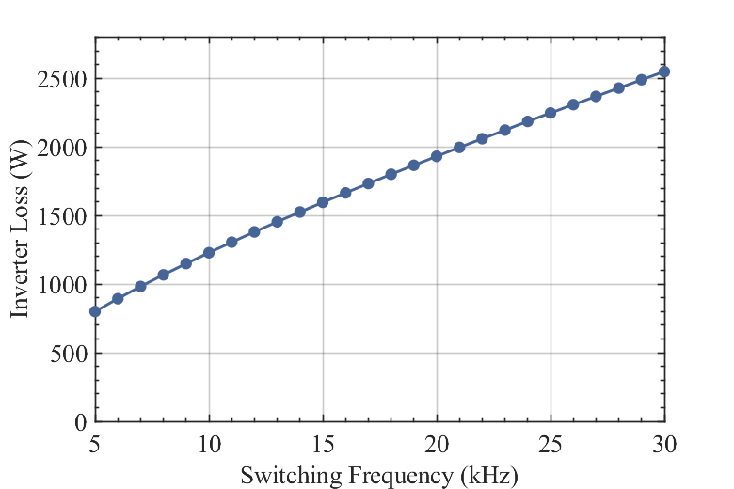
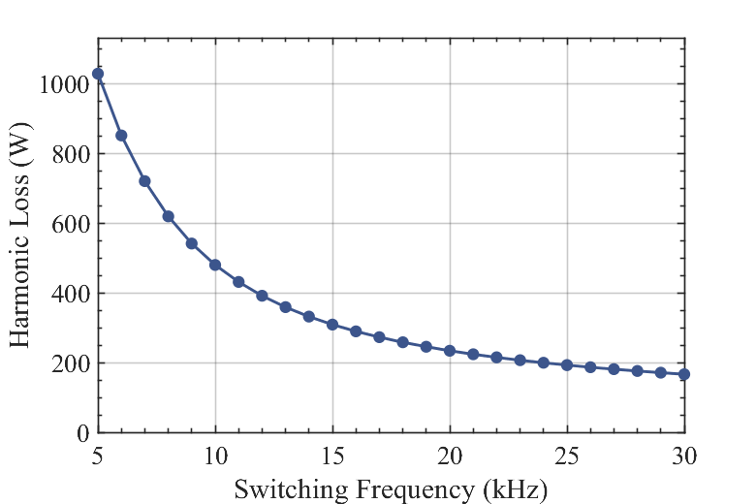
System-Level Efficiency and Loss Trade-offs
Total losses = inverter + motor harmonic losses.
Inverter losses increase with switching frequency,while motor harmonic losses decrease — trade-off point ≈ 14 kHz.
Equal-loss design ensures fair comparison between 800 V and 1200 V systems.
Holistic optimization yields η ≈ 99.3 % and ρ_P ≈ 30 kW/L at 1200 V.
Analytical results validated via calorimetric measurements (Δ < 3 %).
Improved overall efficiency → lower lifecycle energy cost and thermal load.
Enes Ayaz enesa@kth.se

